Slide 1


Introduction to... Arduino
CS-OUTREACH WORKSHOPS
Notes:
This presentation demonstrates the new capabilities of PowerPoint and it is best viewed in Slide Show. These slides are designed to give you great ideas for the presentations you’ll create in PowerPoint 2010!
For more sample templates, click the File tab, and then on the New tab, click Sample Templates.

Slide 2
Contents:
Introduction
What is Micro-Controller?
What is Arduino?
Types of Arduino.
Arduino UNO board.
Sensors:
- Digital, Analog sensors.
- Light sensors [IR sensor, Photo-Resistor].
Coding structure and examples
Data types and operators.
What is “Function”?
Control statements [if, if… else, switch case.].
Loop statements[while, for, do… while.].
Common functions.
Workshop

Slide 3
Introduction
1
Design, organize, and collaborate

Slide 4

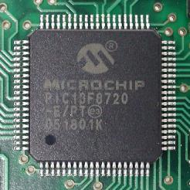
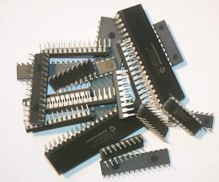
Micro-Controller:
It is a micro-computer. As any computer it has internal CPU, RAM, IOs interface.
It is used for control purposes, and for data analysis.
Famous microcontroller manufacturers are MicroChip, Atmel, Intel, Analog devices, and more.
[list]

Slide 5


What is Arduino?
A microcontroller board, contains on-board power supply, USB port to communicate with PC, and an Atmel microcontroller chip.
It simplify the process of creating any control system by providing the standard board that can be programmed and connected to the system without the need to any sophisticated PCB design and implementation.
It is an open source hardware, any one can get the details of its design and modify it or make his own one himself.
Arduino.

Slide 6
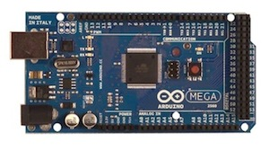
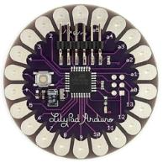
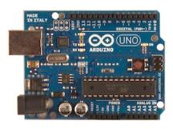
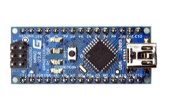
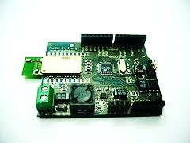
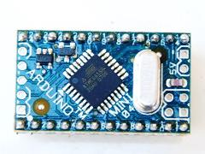
Arduino boards
UNO
Mega
LilyPad
Arduino BT
Arduino Nano
Arduino Mini

Slide 7

Digital output
~: PWM.
0,1: Serial port.
In circuit Serial programming
Atmel MicroController
USB port
Power input
Analog input.
Power Supply

Slide 8
Digital or Analog?
All physical quantities are analog.
Analog means that the quantity can take any value between its minimum value and maximum value.
Digital means that the quantity can take specific levels of values with specific offset between each other.
Ex: 1- Digital:
English alpha consists of 26 letter, there is no letter between A and B.
- Square waves are Digital.
Ex.: 2- Analog:
Temperature, can take any value[-1,12.8,25.002,… etc.].
- Sine waves are analog.
Digital and analog.

Slide 9
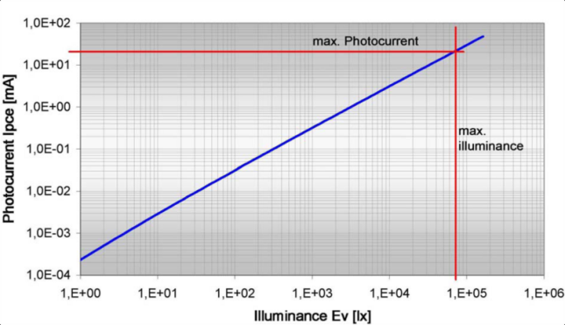
Sensors:
A device that transforms the physical quantity into electrical value.
Ex.: Light sensor transduce the light into change in voltage or resistance.
Sensors

Slide 10
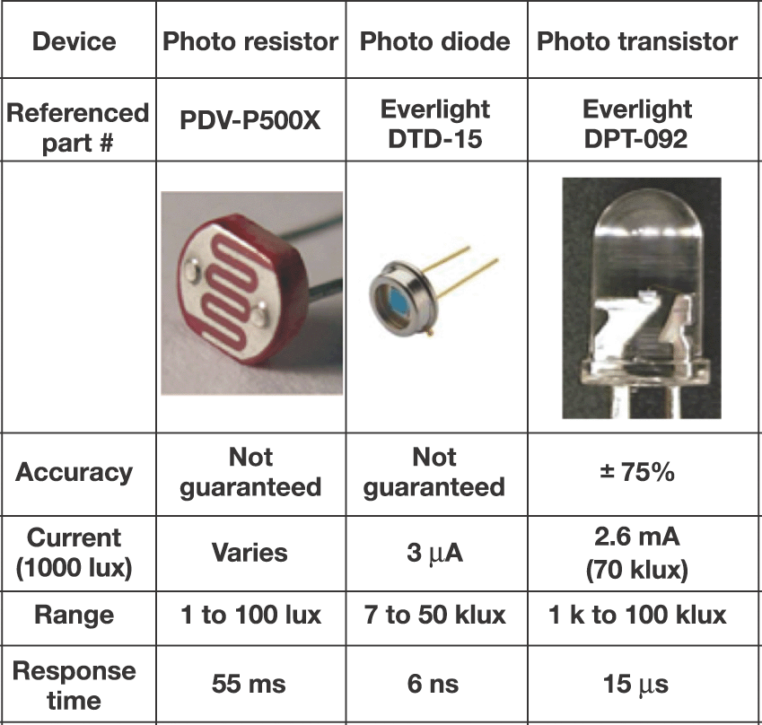
Light sensors:
Photo-Resistor [photo-cell].
Photo-Diode.
Photo-Transistor.
Sensors
Notes:
http://hades.mech.northwestern.edu/index.php/Optoreflector
http://hades.mech.northwestern.edu/index.php/Optointerrupter

Slide 11
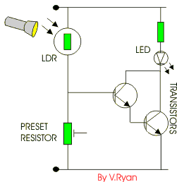
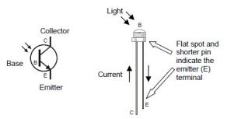
Photo Resistor:
The value of the resistance depends on the incident light density.
1 K-Ohm at light, 10 K-Ohm at darkness.
Sensors
Photo Diode:
The current is controlled by the incident light density.
Photo Transistor:
Base-emitter junction is controlled by the incident light density, has an amplification effect.
Notes:
http://hades.mech.northwestern.edu/index.php/Optoreflector
http://hades.mech.northwestern.edu/index.php/Optointerrupter
http://learn.parallax.com/node/299

Slide 12

Arduino Coding.
2
Stylize, edit, and animate your media

Slide 13


Data Types and operators
Integer: used with integer variables with value between 2147483647 and -2147483647.
Ex: int x=1200;
Character: used with single character, represent value from -127 to 128.
Ex. char c=‘r’;
Long: Long variables are extended size variables for number storage, and store 32 bits (4 bytes), from -2,147,483,648 to 2,147,483,647.
Ex. long u=199203;
Floating-point numbers can be as large as 3.4028235E+38 and as low as -3.4028235E+38. They are stored as 32 bits (4 bytes) of information.
Ex. float num=1.291; [The same as double type]

Slide 14
Statement and operators:
Statement represents a command, it ends with ;
Ex:
int x;
x=13;
Operators are symbols that used to indicate a specific function:
- Math operators: [+,-,*,/,%,^]
- Logic operators: [==, !=, &&, ||]
- Comparison operators: [==, >, <, !=, <=, >=]
Syntax:
; Semicolon, {} curly braces, //single line comment, /*Multi-line comments*/

Slide 15
Statement and operators:
Compound Operators:
++ (increment)
-- (decrement)
+= (compound addition)
-= (compound subtraction)
*= (compound multiplication)
/= (compound division)

Slide 16
Control statements:
If Conditioning:
if(condition)
{
statements-1;
…
Statement-N;
}
else if(condition2)
{
Statements;
}
Else{statements;}

Slide 17
Control statements:
Switch case:
switch (var) {
case 1:
//do something when var equals 1
break;
case 2:
//do something when var equals 2
break;
default:
// if nothing else matches, do the default
// default is optional
}

Slide 18

Loop statements:
Do… while:
do
{
Statements;
}
while(condition); // the statements are run at least once.
While:
While(condition)
{statements;}
for
for (int i=0; i <= val; i++){
statements;
}
Use break statement to stop the loop whenever needed.

Slide 19

Code structure:
Void setup(){}
Used to indicate the initial values of system on starting.
Void loop(){}
Contains the statements that will run whenever the system is powered after setup.

Slide 20
Input and output:
Led blinking example:
Used functions:
pinMode();
digitalRead();
digitalWrite();
delay(time_ms);
other functions:
analogRead();
analogWrite();//PWM.

Slide 21
Workshop

Slide 22





LET’s BEGIN ☺
IEEE MiniaSB.

